Slide 1

Writing for Alfresco
Helen Mullally, User Assistance Manager
@AlfrescoDocs

Slide 2

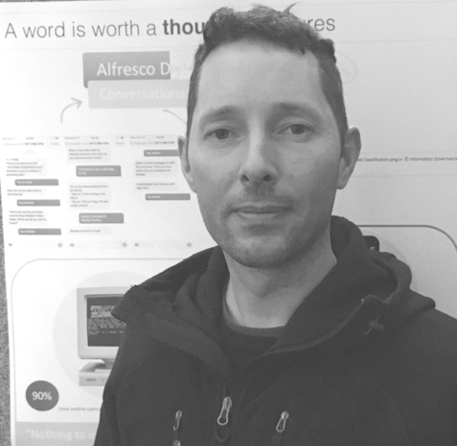

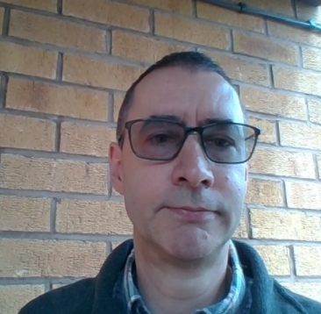
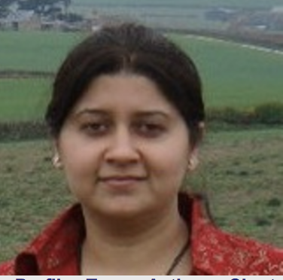

Meet the UA Team
Andy Healey
Adelaide Nxumalo
Adrian Searle
Manu Gaur
Helen Mullally

Slide 3
Meet the UA Team
Andy Healey
Adelaide Nxumalo
Adrian Searle
Manu Gaur
Helen Mullally
◉

Slide 4
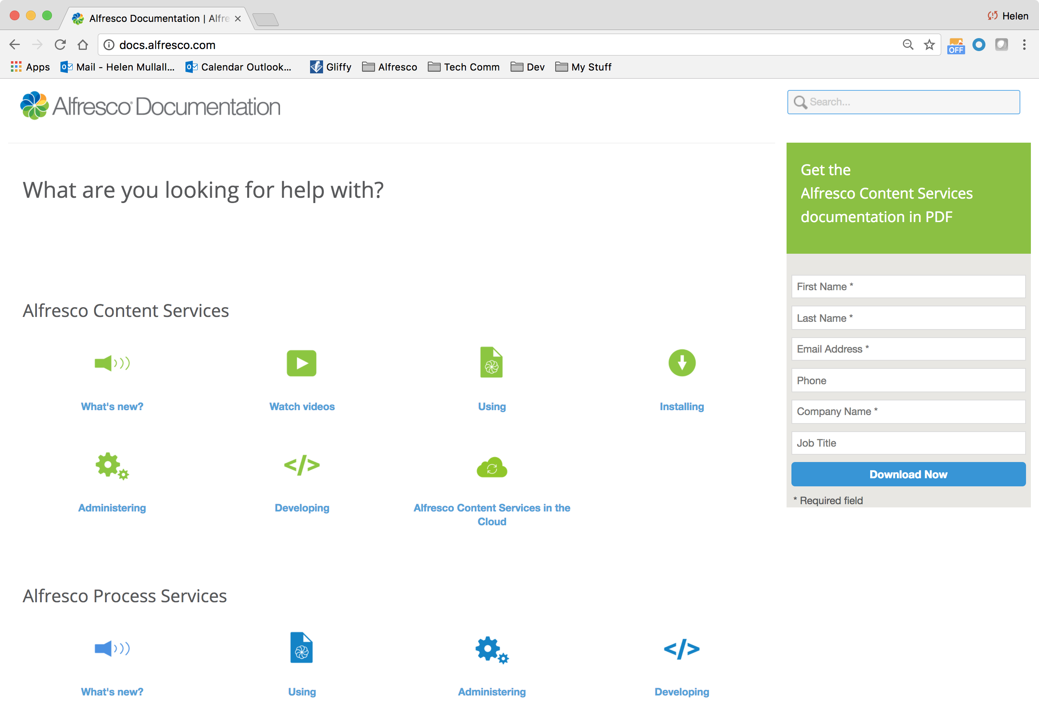
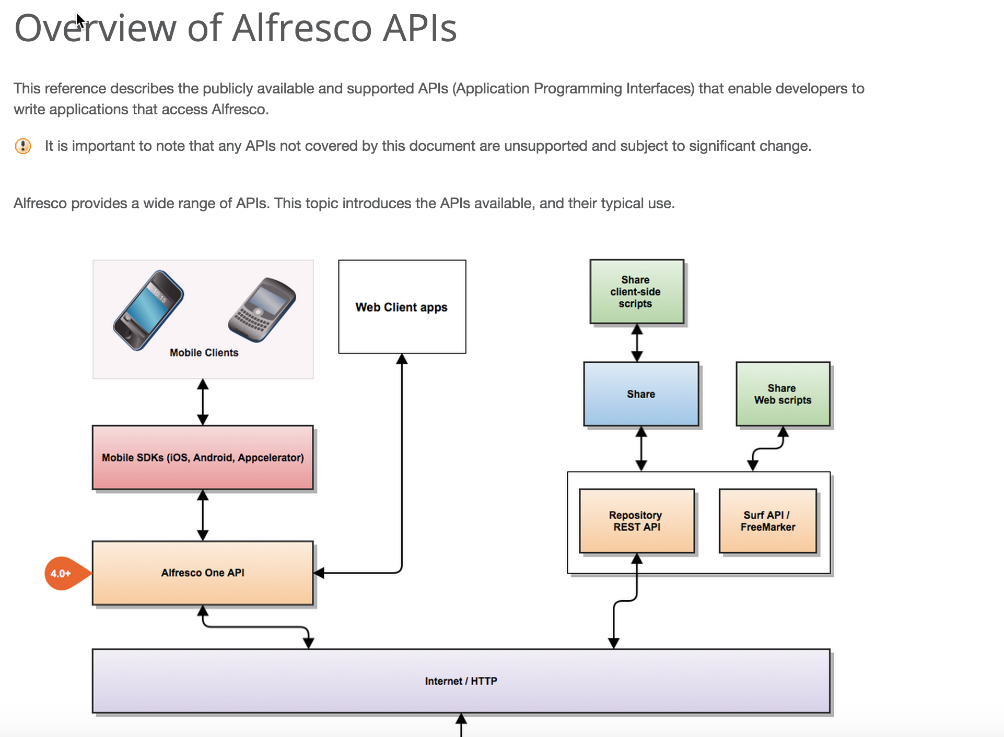
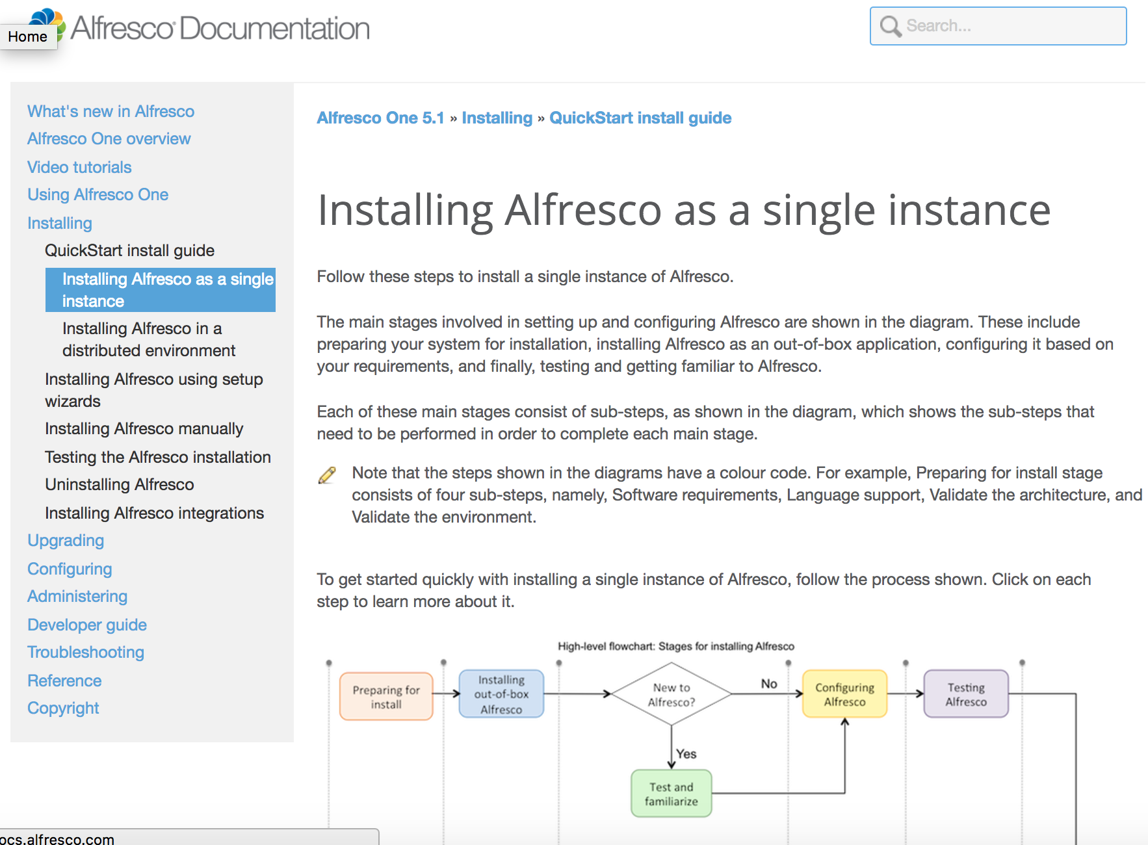
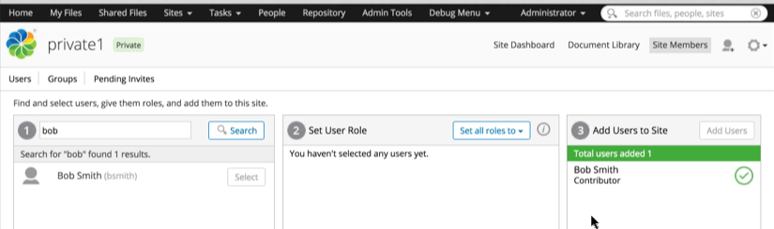
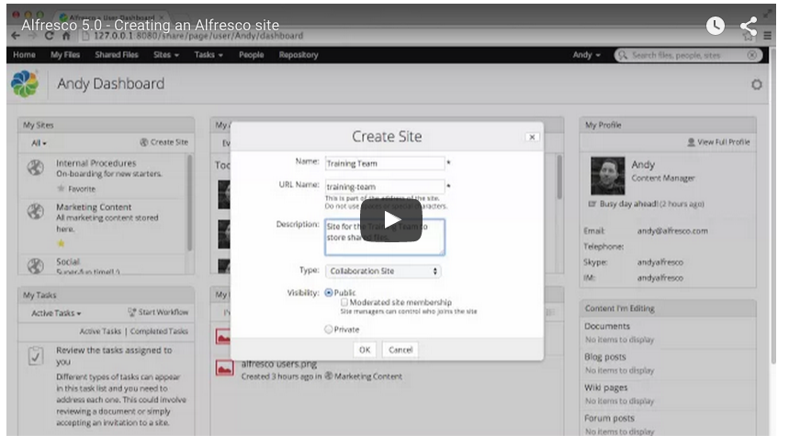
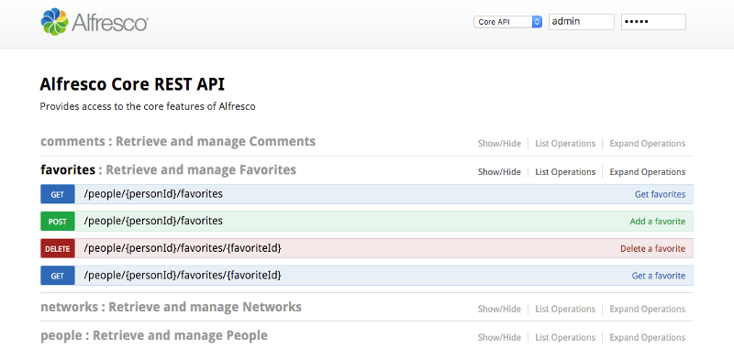
docs.alfresco.com
What do we do
Developer docs
Install guide
UI copy
(help built into the product)
Step-by-step videos
REST API Explorer

Slide 5
docs.alfresco.com
What do we do
Developer docs
Install guide
UI copy
(help built into the product)
Step-by-step videos
REST API Explorer

Slide 6
docs.alfresco.com
What do we do
Developer docs
Install guide
UI copy
(help built into the product)
Step-by-step videos
REST API Explorer

Slide 7
docs.alfresco.com
What do we do
Developer docs
Install guide
UI copy
(help built into the product)
Step-by-step videos
REST API Explorer

Slide 8
docs.alfresco.com
What do we do
Developer docs
Install guide
UI copy
(help built into the product)
Step-by-step videos
REST API Explorer
◉

Slide 9

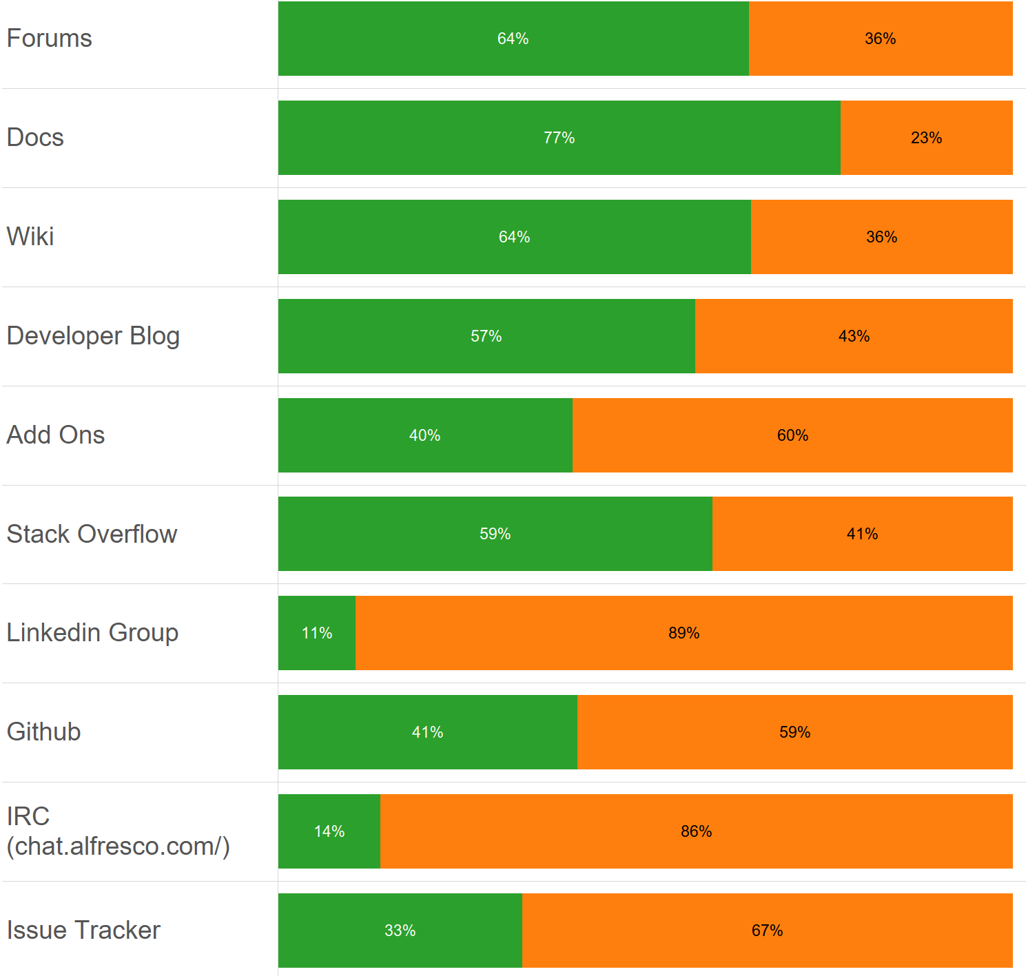
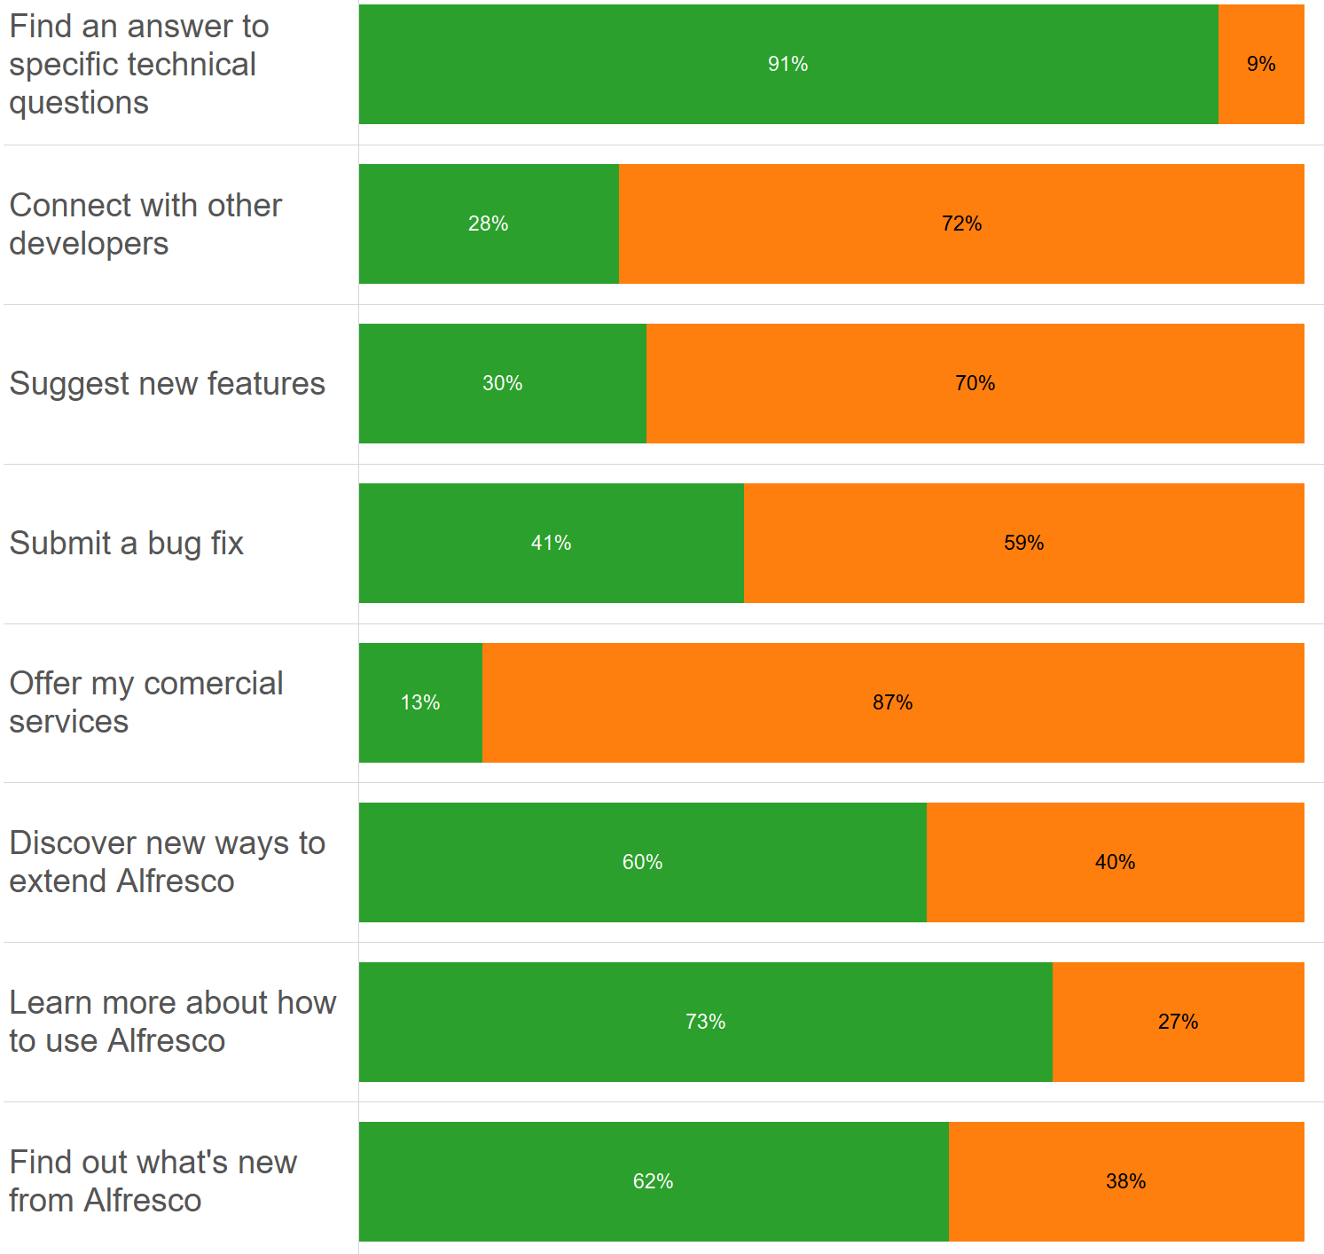
What have you told us?
Which Alfresco resources are most useful?
Why do you use these resources?

Slide 10
What have you told us?
Which Alfresco resources are most useful?
Why do you use these resources?

Slide 11
What have you told us?
Which Alfresco resources are most useful?
Why do you use these resources?

Slide 12
What have you told us?
Which Alfresco resources are most useful?
Why do you use these resources?
◉

Slide 13
What is missing from the docs?
Usage examples
Sample code
Tutorials
Technical videos

Slide 14
What is missing from the docs?
Usage examples
Sample code
Tutorials
Technical videos

Slide 15
What is missing from the docs?
Usage examples
Sample code
Tutorials
Technical videos

Slide 16
What is missing from the docs?
Usage examples
Sample code
Tutorials
Technical videos
◉

Slide 17


Helen Mullally
helen.mullally@alfresco.com
docs.alfresco.com
@AlfrescoDocs

Slide 18
Helen Mullally
helen.mullally@alfresco.com
docs.alfresco.com
@AlfrescoDocs

Slide 19
Helen Mullally
helen.mullally@alfresco.com
docs.alfresco.com
@AlfrescoDocs

Slide 20
Helen Mullally
helen.mullally@alfresco.com
docs.alfresco.com
@AlfrescoDocs
◉

